Slide 1
WELCOME
TO OUR TODAY’S PRESENTATION
PROJECT PRESENTED BY WILLIAM’S TE@M

Slide 2

SCRIPTSENSE AI USING DEEP LEARNING
MASTER OF COMPUTER APPLICATIONS
Submitted by
K. WILLIAM MARK (24002I0001)
A. RAMANA (24002I0008)
MD. FIZA BEGUM (24002I0030)
Guided by Mr. D Rajani Kumar Sir
Lecture Of Computer Science
UNIVERSITY POST GRADUATE COLLEGE, SUBEDARI
KAKATIYA UNIVERSITY
HANUMAKONDA
2023-2025

Slide 3
Todays agenda
Abstract Introduction : Existing System Proposed system System design : System Architecture UML Use Case Diagram Sequence Diagram Class Diagram Activity Diagram | Technologies Used Modules System Testing System Requirements Screenshots Future Enhancement Conclusion

Slide 4

ABSTRACT
A Python-based application designed to evaluate students' handwritten answers using machine learning and natural language processing (NLP).
The System aims to automate and streamline the grading process by extracting text from handwritten answer images, comparing it with model answers, and provides a score based on the correctness and genuineness of the response.
The system integrates sophisticated algorithms to match the extracted text with the actual answer, identifying variations in phrasing while preserving the meaning. Scoring is based on metrics like keyword matching, sentence similarity and semantic analysis, which collectively ensure a fair and comprehensive evaluation.

Slide 5
INTRODUCTION :
The evaluation of students’ handwritten scripts is a fundamental component of the education system. It enables educators to assess knowledge, understanding, and problem-solving abilities.
However, the traditional manual grading process poses significant challenges. They are:
large-scale assessments
time-consuming
labor-intensive
prone to subjective biases and human error
These limitations underscore the need for innovative solutions that can streamline the grading process, reduce manual effort, and ensure consistent and objective evaluations.
This project addresses these challenges by leveraging advancements in machine learning (ML) and natural language processing (NLP) to develop an automated Python-based system for evaluating handwritten answers

Slide 6
EXISTING SYSTEM :
Manual grading involves physically reviewing each answer sheet. This approach allows for human judgment and flexibility.
In an attempt to alleviate these issues, several semi-automated and automated systems have been developed. Existing automated systems primarily utilize Optical Character Recognition (OCR) technologies to extract text from handwritten answer sheets. But there is no process of evaluation.
A Handwritten Test Paper Correction System using NLTK and Machine Learning integrates OCR, NLP, and ML for automated evaluation.

Slide 7
PROPOSED SYSTEM :
A Handwritten Test Paper Correction System using NLTK and Machine Learning integrates OCR, NLP, and ML for automated evaluation.
Preprocessing using Natural Language Toolkit (NLTK), including tokenization, stop word removal, and lemmatization.
OCR tools like Tesseract or deep learning-based models extract text from scanned answer sheets.
Similarity comparison techniques and ML models classify and score answers based on rubrics.
Finally, a grading module generates the score.

Slide 8
System Design
A System Design Diagram in UML (Unified Modeling Language) refers to a visual representation of how the components of a system are organized and how they interact. It's a way to show the overall structure and flow within the system. For a project like "Handwriting Score," which involves an automated evaluation system for handwritten answers using OCR and NLP, various UML diagram types can be used to represent the system design effectively. Here's a brief explanation of some of the common UML diagrams:

Slide 9
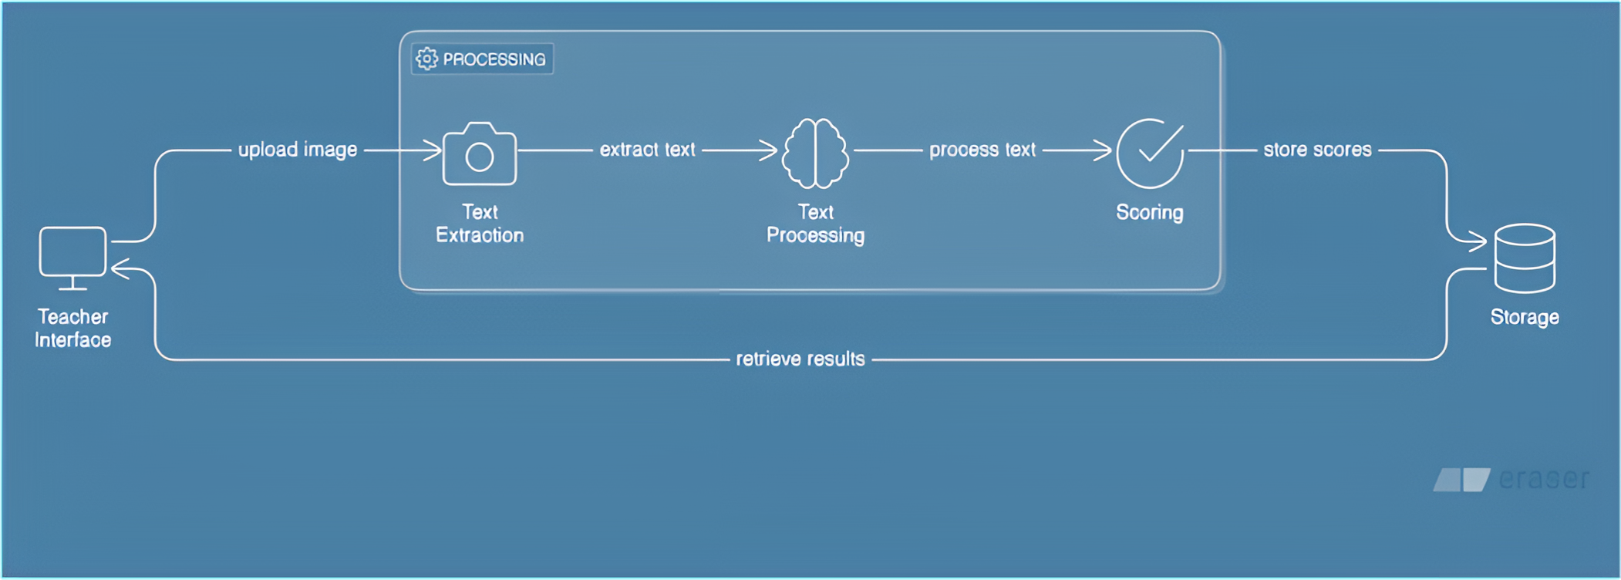
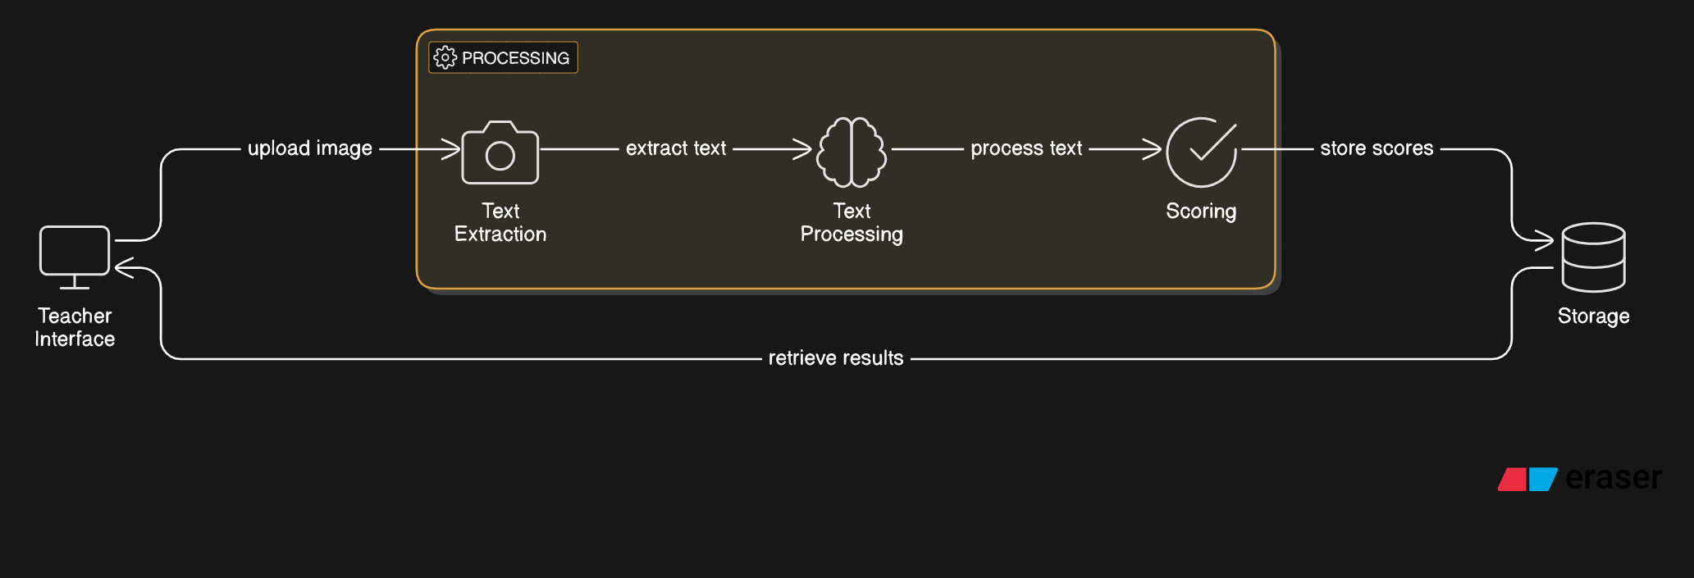
SYSTEM ARCHITECTURE

Slide 10
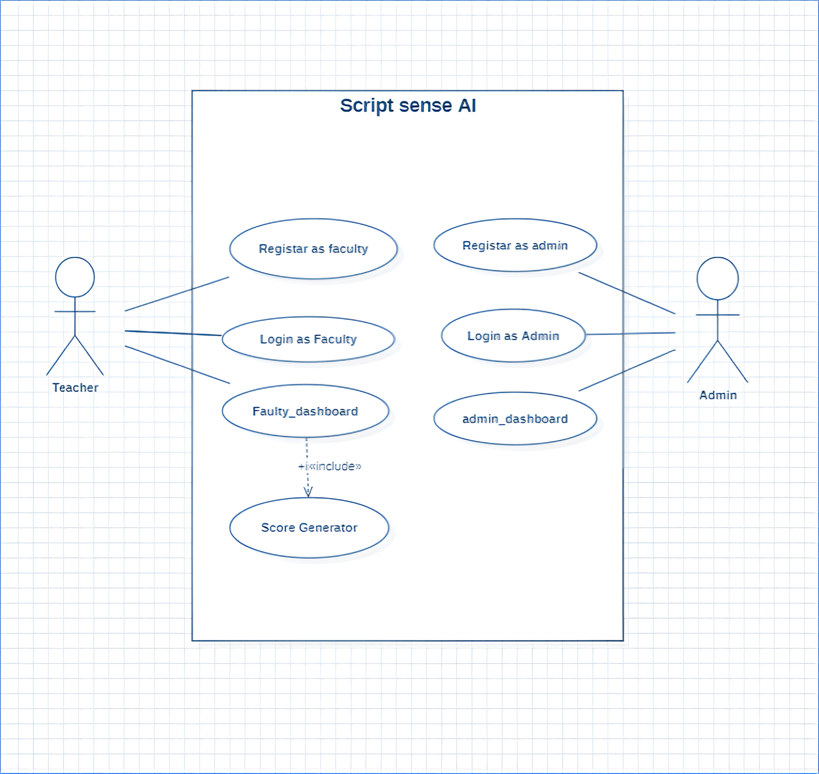
Use case Diagram:

Slide 11
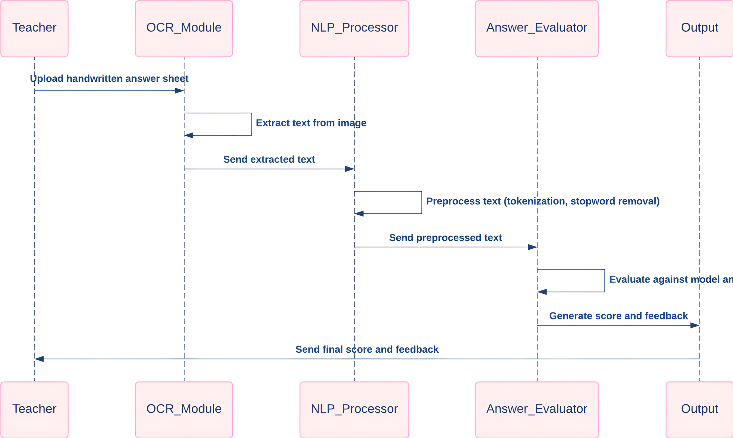
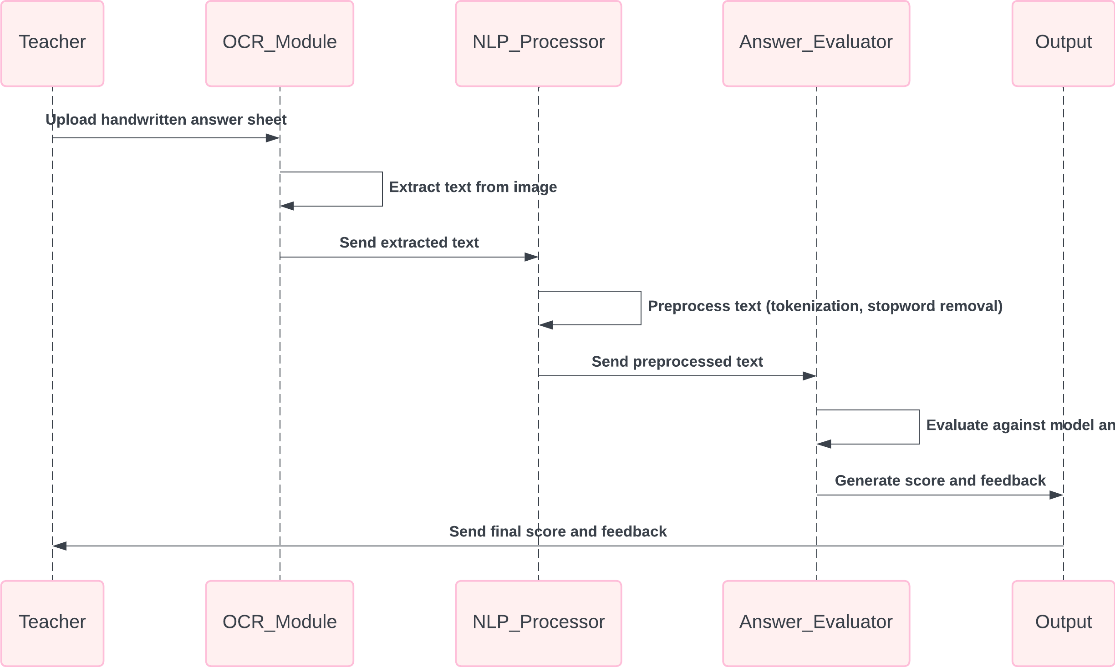
SEQUENCE DIAGRAM:

Slide 12
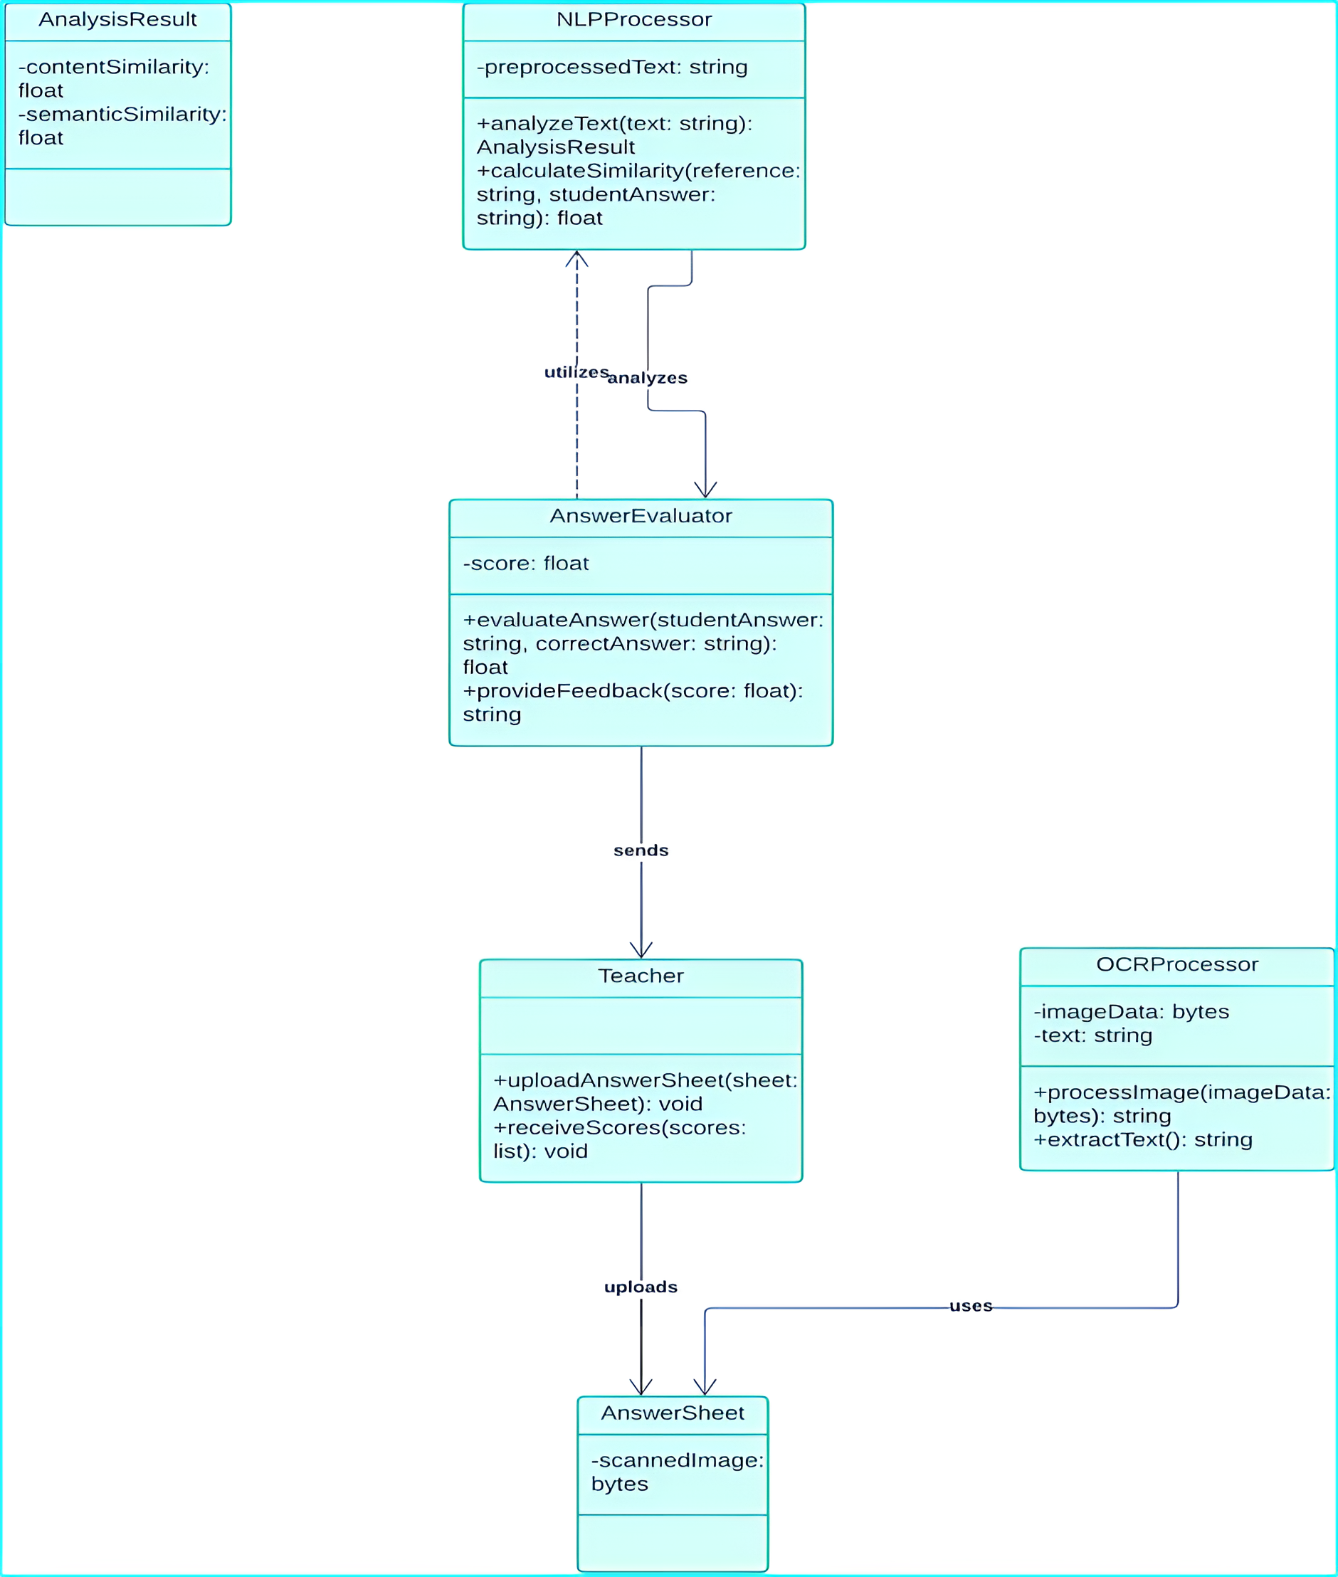
CLASS DIAGRAM:
In software engineering, a class diagram in the Unified Modelling Language (UML) is a type of static structure diagram that describes the structure of a system by showing the system's classes, their attributes, operations (or methods), and the relationships among the classes. It explains which class contains information.

Slide 13
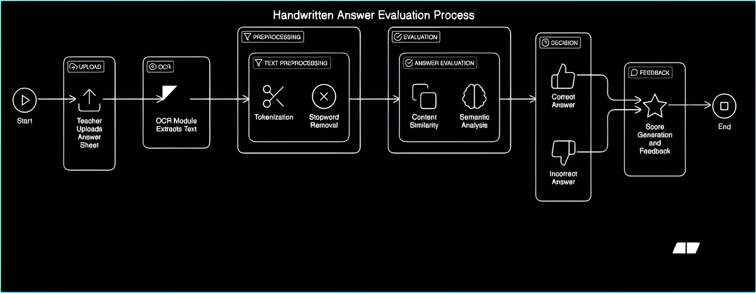
ACTIVITY DIAGRAM:

Slide 14
Technologies Used
Scikit-learn A machine learning library that provides simple and efficient tools for data mining and analysis, including classification, regression, and clustering algorithms.
Open CV : It's a super popular open-source library used mainly for computer vision, image processing, and machine learning tasks.
Flask : it’s lightweight Python framework that lets you quickly create web apps or APIs by turning your Python code into a website.
OCR (Optical Character Recognition) : it is a technology that reads and converts text from images or scanned documents into editable digital text.
NLP (Natural Language Processing) : NLP (Natural Language Processing) is a branch of AI that helps computers understand, interpret, and generate human language.
SQL (Structured Query Language) : is the language used to store, manage, and retrieve data from databases.

Slide 15
ARTIFICIAL INTELLIGENCE VS MACHINE LEARNING VS DEEP LEARNING
AI | ML | DL
Artificial Intelligence, refers to the simulation of human intelligence in machines that are designed to think, learn, and perform tasks that typically require human cognition. AI can process large amounts of data, recognize patterns, and make decisions based on predefined algorithms or real-time learning. automate tasks, and improve security. | Machine Learning (ML) is a subset of Artificial Intelligence (AI) that enables computers to learn from data and make decisions without being explicitly programmed. Instead of following fixed instructions, ML algorithms analyze patterns, improve from experience, and make predictions | Deep Learning (DL) is a subset of Machine Learning (ML) that focuses on using neural networks with multiple layers to process data in complex ways. It mimics the way the human brain works, allowing computers to learn patterns, recognize features, and make decisions without manual programming

Slide 16
Modules
1. Handwritten Text Extraction (OCR Module):
The first step in the process is extracting the handwritten text from the uploaded answer sheet. This is achieved using Optical Character Recognition (OCR), a technology that allows computers to read and convert different types of documents into machine-readable text.
For this system, we use the Tesseract OCR engine, an open-source tool that is widely recognized for its effectiveness in recognizing printed and handwritten text. The OCR module is responsible for scanning the uploaded image, detecting text regions, and converting them into digital text.
The implementation of the OCR module begins by pre-processing the uploaded image to improve the text recognition accuracy.
Image Preprocessing
Text Recognition
Text Cleaning

Slide 17
Modules
2. Text Preprocessing (NLP Module):
Once the text is extracted from the image, the next step involves preprocessing the text to make it suitable for evaluation. This process is crucial because raw text extracted from images often contains noise, such as misspellings, extra spaces, and irrelevant words. Text preprocessing ensures that the system can effectively compare the student’s answer to the correct model answer.
The NLP module implements several preprocessing steps, such as:
Tokenization
Stemming and Lemmatization
Stopword Removal
Text Normalization

Slide 18
Modules
3. Answer Evaluation (Answer Evaluator):
The heart of the system lies in answer evaluation, where the student’s response is compared to the model answers. This process is based on two main techniques:
Content Similarity: This technique compares the student’s answer to the model answer by calculating the similarity between their content. Common algorithms used for content similarity include Cosine Similarity, Jaccard Similarity, and Levenshtein Distance. For this project, Cosine Similarity is used, as it is effective for comparing the frequency of word usage in a document.
Semantic Analysis: While content similarity focuses on the presence of common words, semantic analysis evaluates whether the student’s answer conveys the correct meaning. This is done using pre-trained models such as Word2Vec or BERT (Bidirectional Encoder Representations from Transformers), which are capable of understanding the semantic meaning of words and sentences.

Slide 19
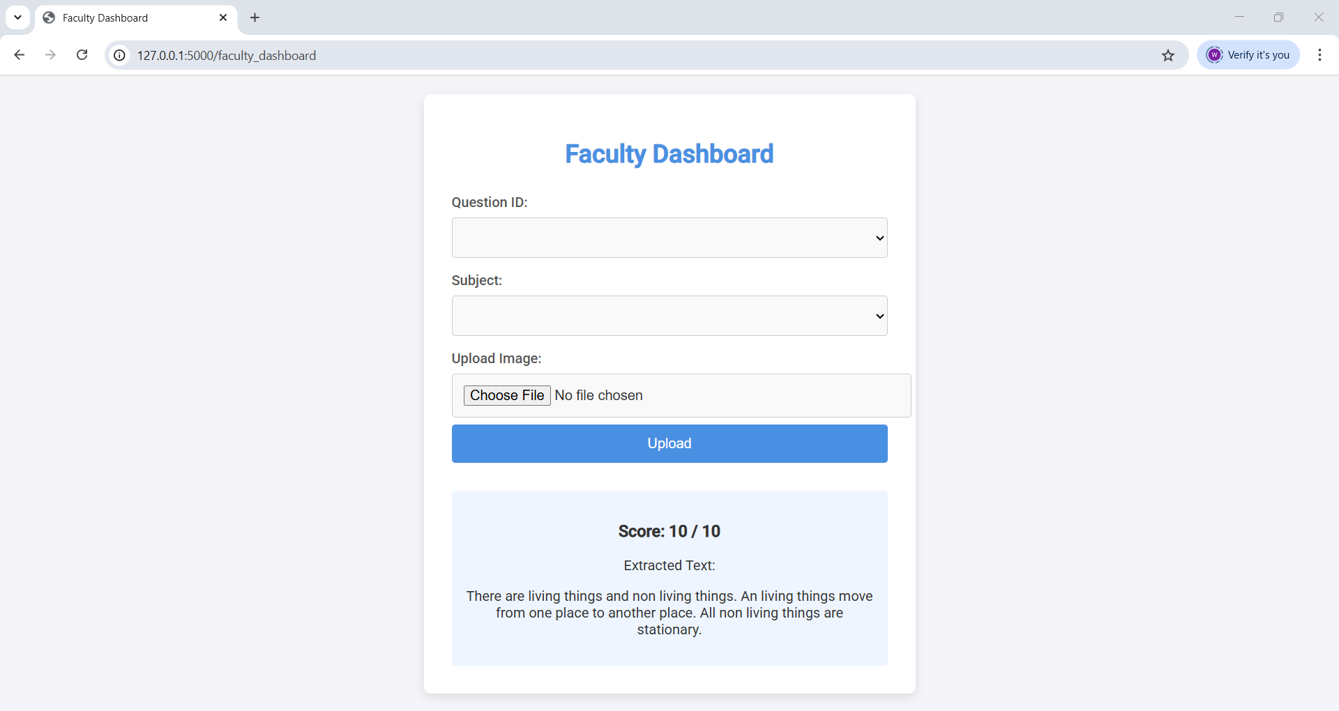
Modules
4. Score generation:
Once the answer has been evaluated, the system generates a score based on the similarity between the student’s answer and the model answer. The score is normalized between 0 and 10, with 10 representing a perfect match.

Slide 20

System REQUIREMENTS
HARDWARE :
System: Intel Core i7
Hard Disk: 1TB
Monitor: 14’’ LED
Input Devices: Keyboard, Mouse
RAM: 16 GB
SOFTWARE :
Operating System: Windows 11
Coding Language: Python
Tool: PyCharm
Software: Python 3.7

Slide 21
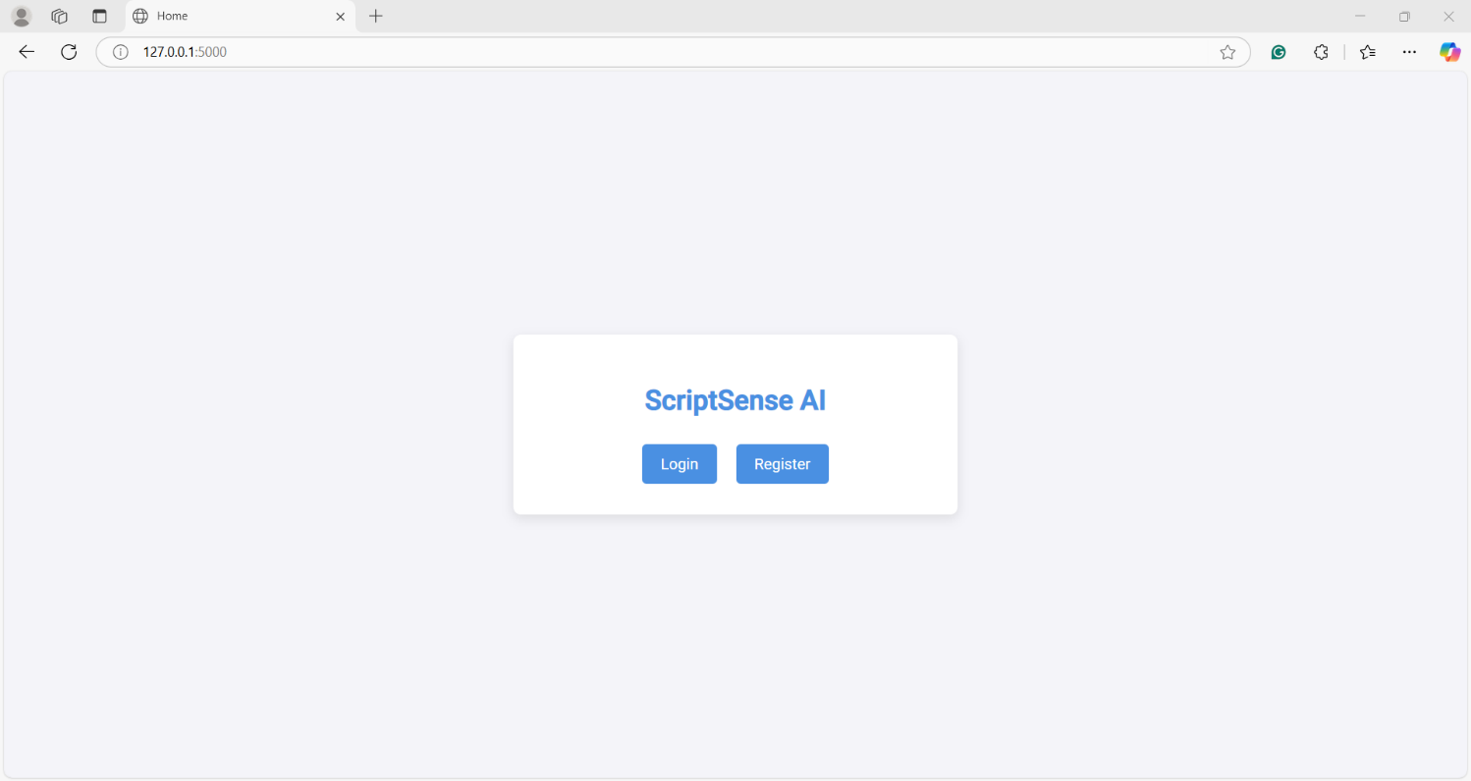
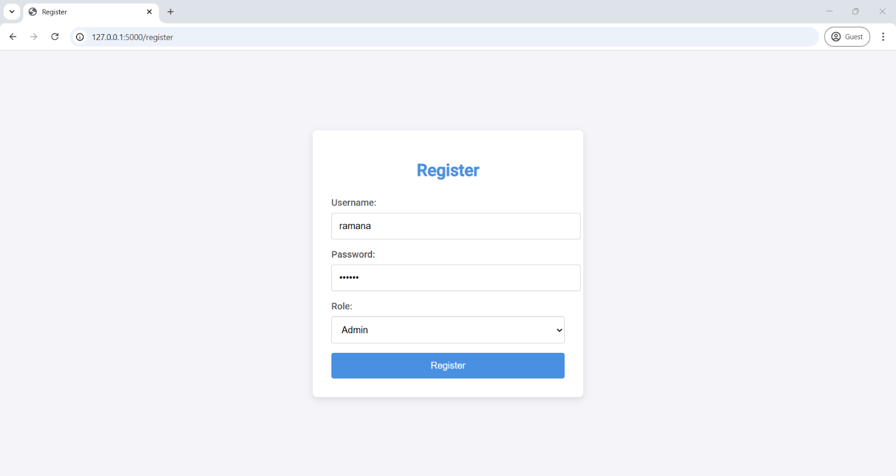
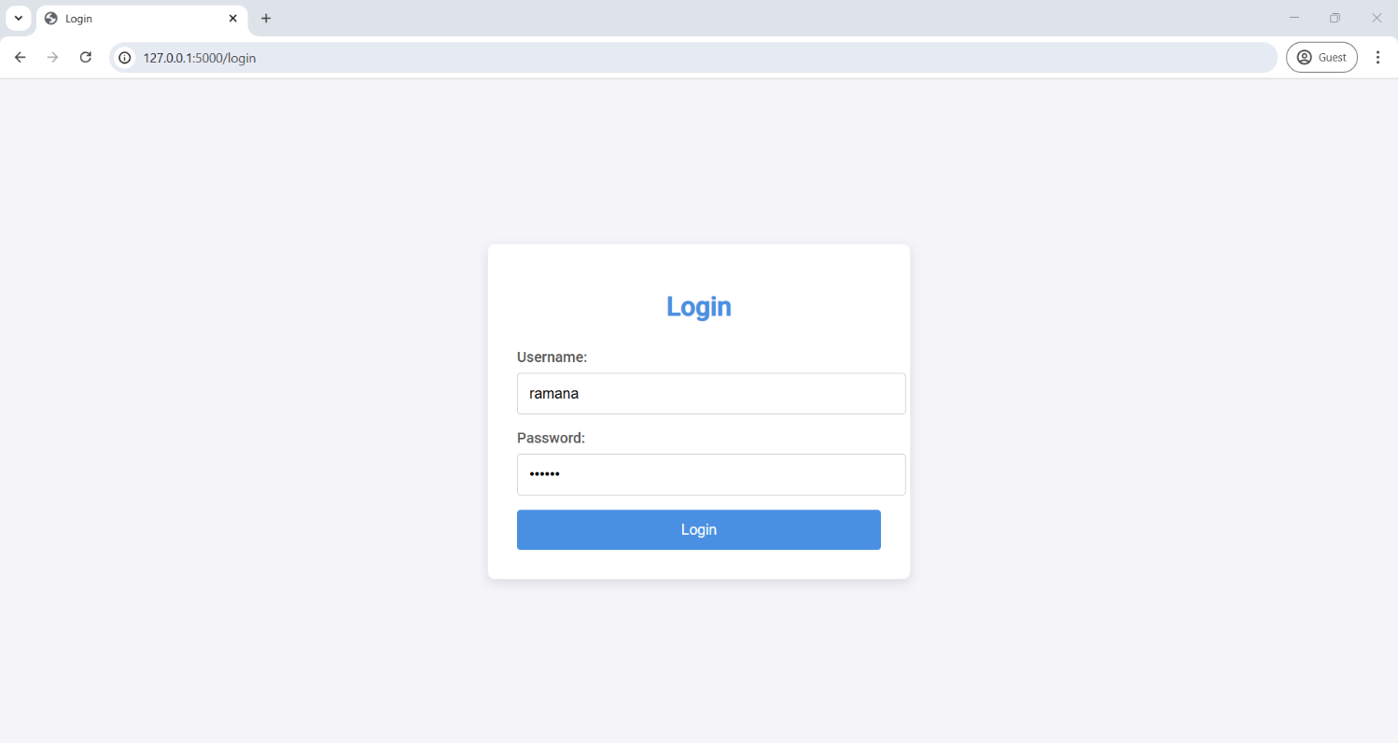
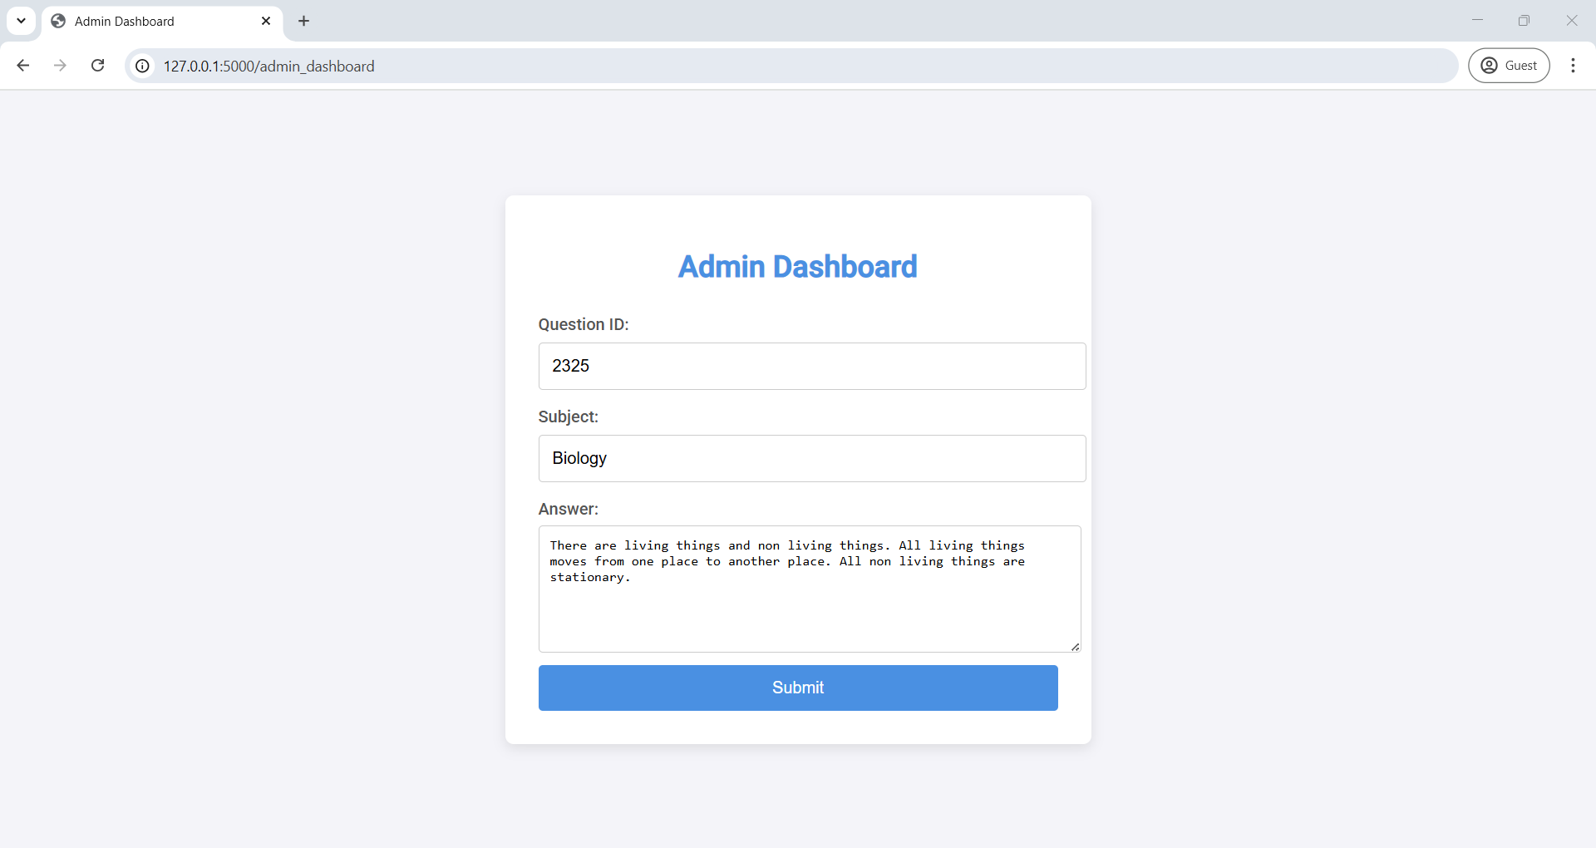
Screenshots

Slide 22
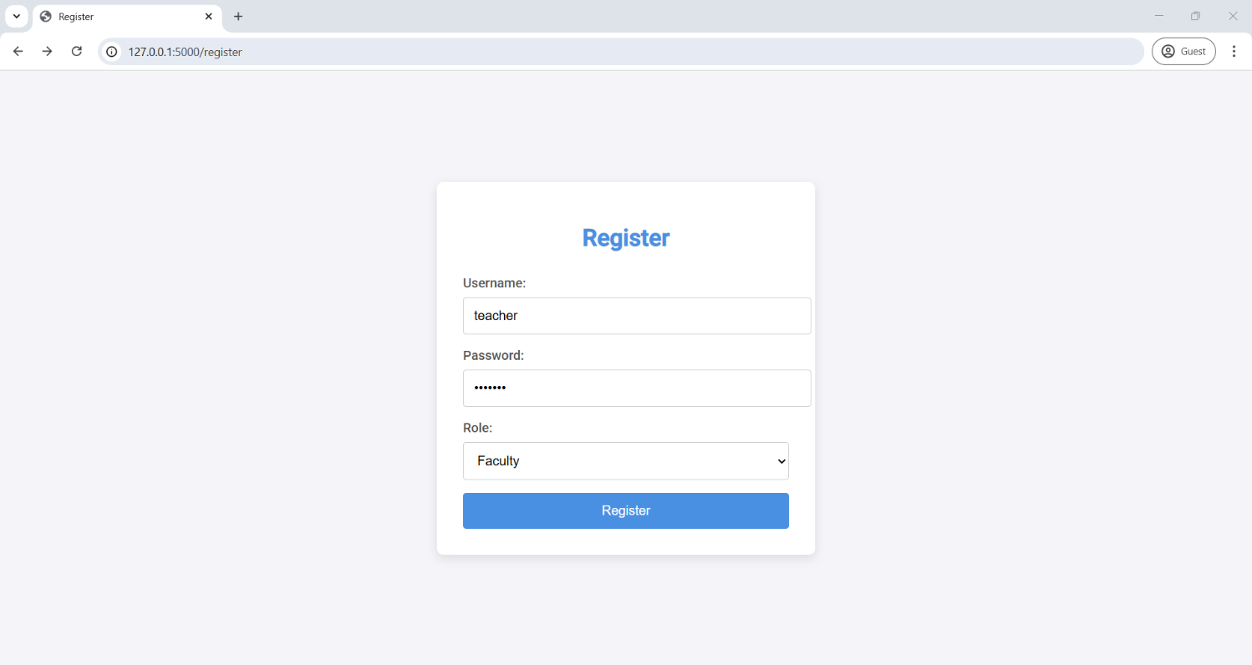

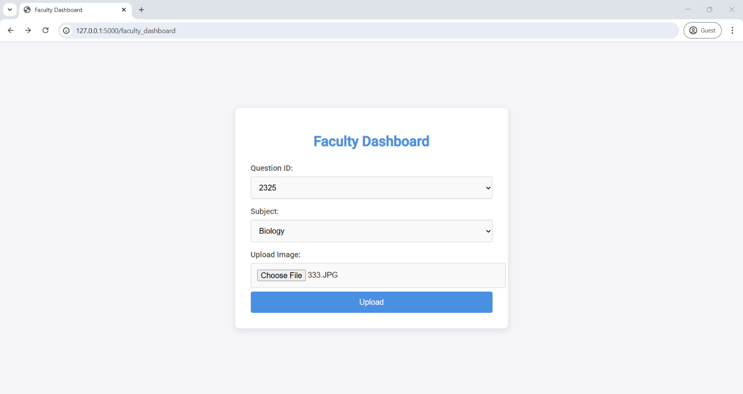
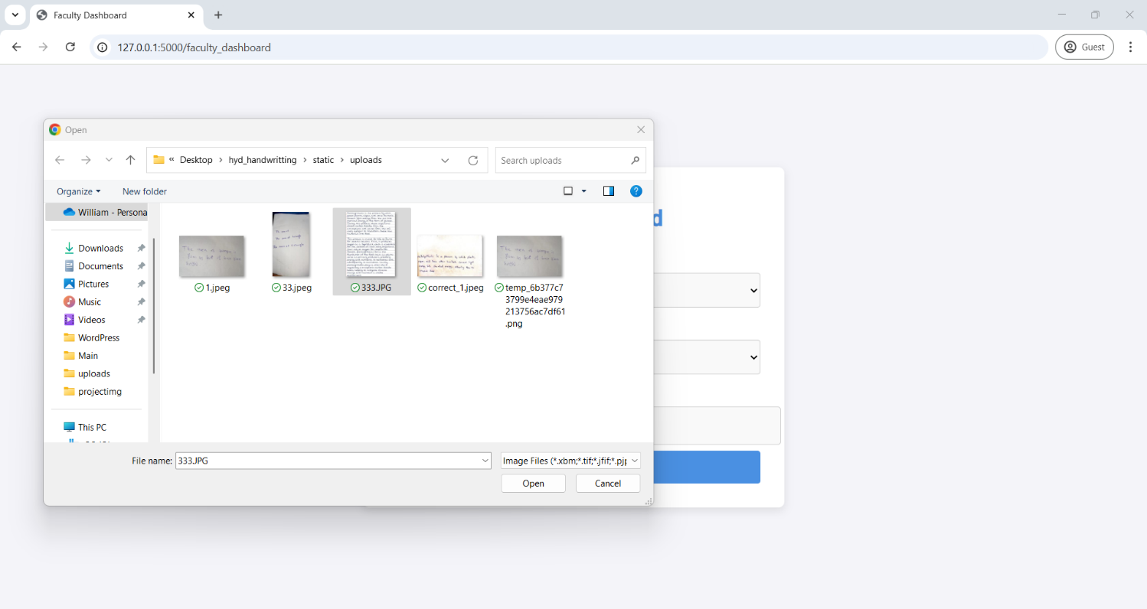
Screenshots

Slide 23
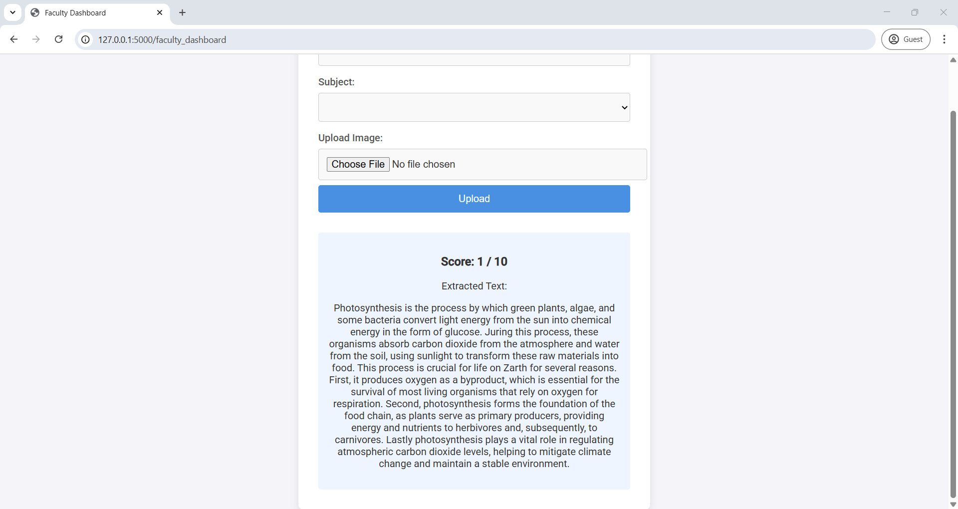
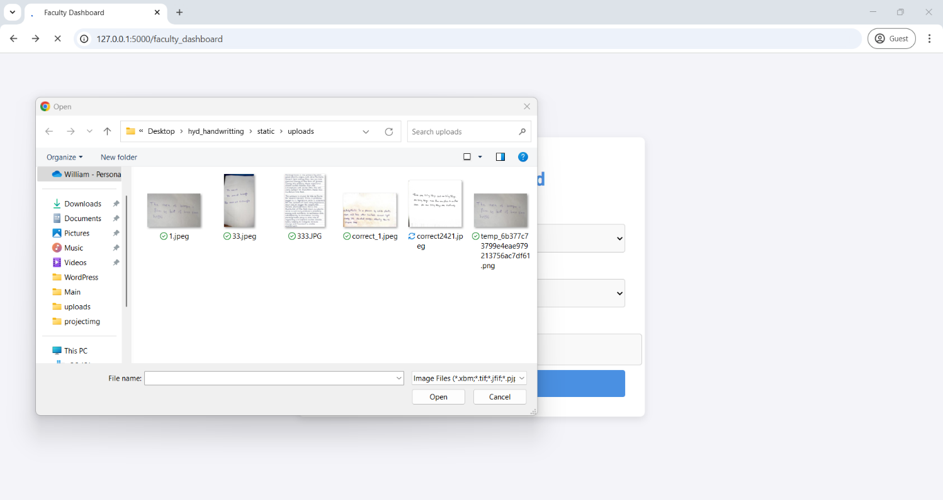
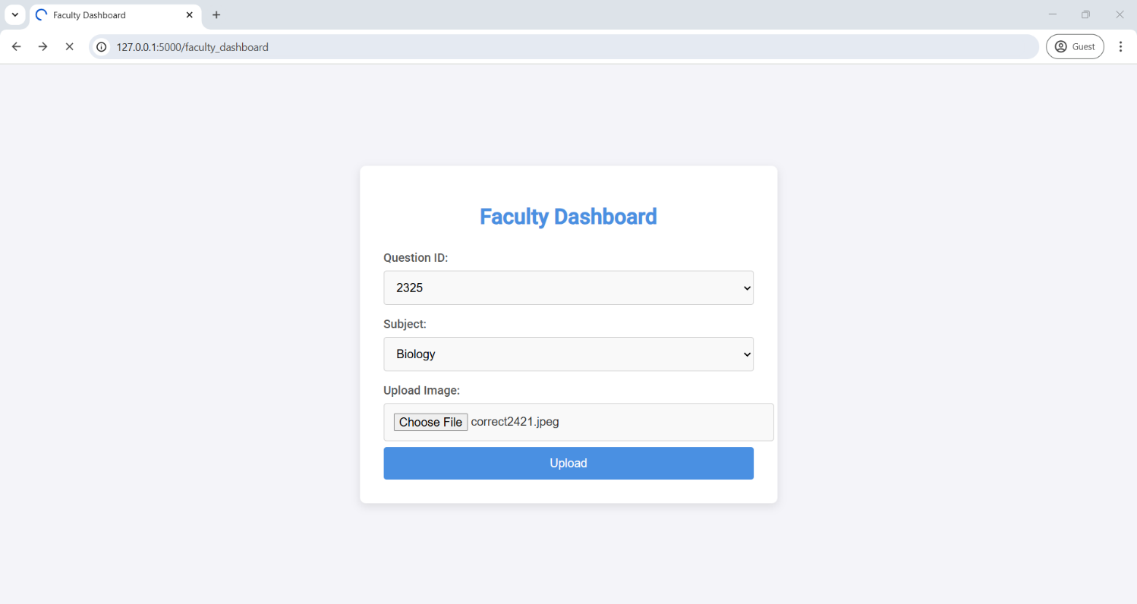
Screenshots

Slide 24
FUTURE ENHANCEMENT
Multilanguage Handwriting Support: Extend recognition beyond English to other languages like Hindi, Telugu, etc.
Advanced Handwriting Styles Recognition: Improve the model to accurately evaluate different handwriting styles (cursive, block letters).
Semantic Understanding: Go beyond keyword matching — understand the meaning of answers to grade concept clarity.
Model Self-Learning: Allow the system to continuously improve by learning from manual corrections done by teachers.
Handwritten Diagrams and Flowchart Evaluation: Recognize and evaluate drawn diagrams.

Slide 25
CONCLUSION
We conclude this presentation with this point that an automated system of paper evaluation helps us fast, accurate and consistent correction of papers.

Slide 26

THANK YOU
FOR LISTENING WITH PATIENCE
Designed By PowerPoint William's Team

